Slide 1
Software Systems Design and Integration
Lecture 11 Part I:
Java Persistence Framework

Slide 2
Aims
Understand the role of JPA in Java EE Applications
Describe the object-relational mapping in database applications
Understand and explain the lifecycle of entity components
Demonstrate the use of entity components in Java EE application

Slide 3
Content
Persistence in Web Container
Persistence in EJB Container
JPA as an API for OR mapping
JPA as an interface for accessing persistent data
Managing the lifecycle of entity classes using JPA
Deploying entity classes to Java EE server

Slide 4
1 Persistence in Web Container
In Web container we may implement some data processing operations which use persistent data (from files or databases)
  for populating drop-down menus with data from a lookup table in the database (backend data)
  for completing the registration using pre-recorded data (frontend data)
The basis for persistence management in Java is JDBC API which is available within both Java SE containers (for desktop applications) and the Java EE containers (for server-side components)
Although JDBC is for Java it inherits relational data model from ODBC developed by Microsoft

Slide 5
Design Considerations
  JDBC sessions can be used for transactional operations in both servlets and JSP pages, but in Java EE applications it is recommended to separate the frontend, middleware and backend sessions
  In Java EE MVC architecture the separation of the components leads to localization of the persistence operations as well
    the servlets are used as controllers, so explicit connections are not recommended inside servlets
    the JSPs are used for views, so any lookup data can be obtained from the databases using suitable tags
    The EJBs are used as models, so persistence management is localized within the EJB container
    If the data needs to be transported between the layers of the architecture we can use beans

Slide 6
Example: Using JDBC inside servlets
try {// get total number of all survey responses
String query = "SELECT sum (votes) FROM surveyresults";
ResultSet totalRS = statement.executeQuery(query);
totalRS.next();
int total = totalRS.getInt(1);
// get individual results
query = "SELECT surveyoption, votes, id
FROM surveyresults ORDER BY id";
ResultSet resultsRS = statement.executeQuery(query);
// process all results in a loop
int votes;
while (resultsRS.next()) {
out.print(resultsRS.getString(1));
out.print(": ");
votes = resultsRS.getInt(2);
out.print(twoDigits.format((double) votes/total*100));
out.print("% responses: ");
out.println(votes);
}
resultsRS.close();
}

Slide 7
Example: Specifying JDBC connection in the application configuration file
public class SurveyServlet extends HttpServlet {
// JDBC placeholders
private Connection connection;
private Statement statement;
public void init(ServletConfig conf) throws ServletException{
// attempt database connection
try {
// Obtain the database conection
conf.getInitParameter("databaseLocation");
Class.forName(config.getInitParameter("databaseDriver"));
connection = DriverManager.getConnection(
config.getInitParameter("databaseName"));
// create Statement to query database
statement = connection.createStatement();
} catch ( Exception exception ) {
// for any exception throw an UnavailableException
exception.printStackTrace();
throw new UnavailableException(exception.getMessage());
}
} // end of init method

Slide 8
Example: Specifying JDBC connection inside the servlets
public class SurveyServlet extends HttpServlet {
// JDBC driver name, database URL and placeholders
static final String JDBC_DRIVER="sun.jdbc.odbc.JdbcOdbcDriver";
static final String DATABASE_URL="jdbc:odbc:animalsurvey";
private Connection connection;
private Statement statement;
// set up database connection and create SQL statement
public void init( ServletConfig config ) throws ServletException{
// attempt database connection and create Statement
try {
Class.forName( JDBC_DRIVER ).newInstance();
connection = DriverManager.getConnection( DATABASE_URL );
statement = connection.createStatement();
} catch ( Exception exception ) {
exception.printStackTrace();
throw new UnavailableException( exception.getMessage() );
}
} // end of init method

Slide 9
Example: Using JDBC inside JSP pages
...
<sql:query dataSource="${employees}" var="result">
SELECT * from Employees;
</sql:query>
<table border="1" width="100%">
<tr><th>Emp ID</th>
<th>First Name</th>
<th>Last Name</th>
<th>Age</th>
</tr>
<c:forEach var="row" items="${result.rows}">
<tr><td><c:out value="${row.id}"/></td>
<td><c:out value="${row.first}"/></td>
<td><c:out value="${row.last}"/></td>
<td><c:out value="${row.age}"/></td>
</tr>
</c:forEach>
</table>
...

Slide 10
Example: Specifying JDBC connection on JSP pages using JSTL
<%@ page import="java.io.*,java.util.*,java.sql.*"%>
<%@ page import="javax.servlet.http.*,javax.servlet.*" %>
<%@ taglib uri="http://java.sun.com/jsp/jstl/core"
prefix="c"%>
<%@ taglib uri="http://java.sun.com/jsp/jstl/sql"
prefix="sql"%>
<html>
<head><title>SELECT Operation</title></head>
<body>
<sql:setDataSource var=“employees"
driver="com.mysql.jdbc.Driver"
url="jdbc:mysql://localhost/HR"
user="root"
password="pass123"/>
...
</body>
</html>

Slide 11
2 Persistence in EJB Container
JDBC does relational mapping (RM) of the Java classes to DB tables (modelled after ODBC)
Example: Classes <-> tables, Objects <-> records.
Attributes <-> columns, Relations <-> key pairs
JPA defines object-relational mapping (ORM) between the Java classes in the application and the tables in the database. It provides an object view of the data within the application regardless the type of storage (databases, flat files, directories, etc.)
  ORM is available not only forJava, but for other OO languages as well (C#, C++, ObjectiveC, etc.)
  Supported by many software tools (originates in TopLink) using industrial ORM frameworks - Hybernate, ObjectLink, etc.

Slide 12
Persistence Management in Java
In Java, there are two methods for persistence management
  Container-managed persistence (available only in Java EE) – automatic by the containers
  Application-managed persistence (available in both Java SE and Java EE) - programmatic
In EJB 3 entity classes which replaced entity EJBs of EJB 2 can be used both inside and outside Java EE server (i.e., in Java SE containers in the client)
Examples: Entity bean Student, Entity bean Module, Entity bean Lecturer, etc.

Slide 13
Persistence Units
Collection of entity classes used in the application (can be stored in a separated .jar file)
File persistence.xml specifies the entity classes used in the application and binds them to a unique data source
Example: Specification of a Persistent unit
<persistence version =“2.0”>
<persistence-unit name=“CourseTool-ejb”
transaction-type=“JTA”>
<jta-data-source>CourseProgram
</jta-data-source>
<jar-file>CourseLib.jar</jar-file>
</persistence-unit>
</persistence>

Slide 14
Persistent data types
Java primitive types (int, boolean, float, double, char...)
Java object wrappers for primitive data types (java.lang.Integer, java.lang.Float, ... etc.)
The collection types for primitive data types byte[] or Byte[], char[] or Character[]
The object type java.lang.String
Serializable types which can be transported, such as java.util.Date, java.sql.Date, java.sql.TimeStamp and user-defined

Slide 15
Persistence Context
Specified using a temporary copy of the persistence unit, active within the scope of an operation for a limited time
  When the persistence unit is used across several transactions, several persistence contexts based on the same unit can be active at the same time
  When the persistence unit is used across several applications, different persistence contexts based on the same unit will be used in each of them
The persistence context is managed by a separate class in JPA API, known as entity manager

Slide 16
3 JPA as a programming API for Object-relational mapping
JPA and EJB
  JPA was originally part of EJB 2.1 Container-managed persistence (CMP)
  It relies on the container services for managing the persistence
JPA as a programmer API
  JPA provides mapping between the object data types in Java and the database data types in SQL
  JPA defines correspondence between each Java object type and a table or group of tables in the database (One-to-many or One-to-one)
JPA allows to manage automatically the Java objects used to hold persistent data (entity classes instances)

Slide 17
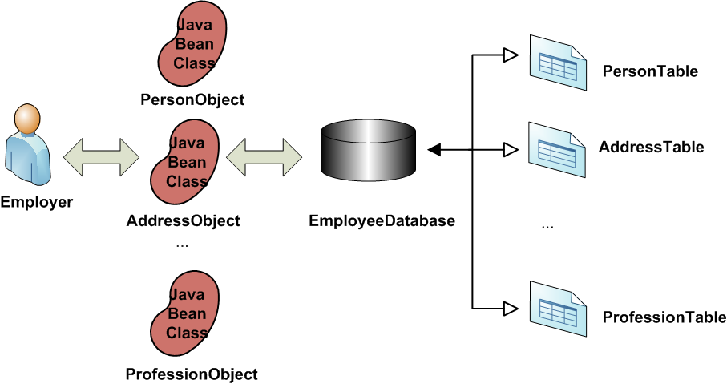
Example: One-to-one mapping of Java classes to tables

Slide 18
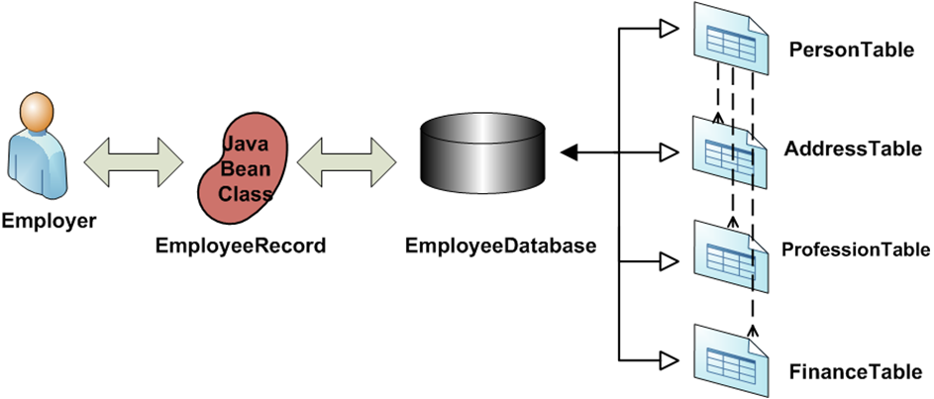
Example: One-to-many mapping of Java classes to tables

Slide 19
3.1 Entity Classes in Java
Top-level (not inner), public (declared in a separate file), extendable (not final)
Annotated with annotations from package javax.persistence: Entity on the class, Table on the database table, Id on the object identifier and Column on the mapped table columns
Constructor without arguments with public or protected access (the container instantiates the bean); additional methods with arguments are also possible
If returned by remote beans must implement the serializable interface as well

Slide 20
Example: Entity Bean Student
import java.io.Serializable;
import javax.persistence.*;
@Entity @Table (name = “STUDENT”)
public class Student implements Serializable {
@Id @Column (name = “StudId”) private int id;
@Column (name = “FamilyName”) private String family;
...
protected Student(){ }
public Student(int studId, String fnm){
this.id = studId; this.family = fnm;
public int getId() {return id;}
public String getFamily() {return family;}
public void setFamily(String fnm){this.family = fnm;}
}

Slide 21
3.2 JPA Annotations
Annotation | Value | Default and Overriding it
@Entity | Entity Class | Specifies the class to be persisted
@Id | Class field | Identifies the persistent object
@Transient | Class field | Suspends the persistence of a field
@Table | Database Table | Dafault name is the class name, or (name=<TableName>)
@Column | Table Column | Default name is the attribute name, or (name=<TableColumnName>)
@GeneratedValue | Table Column Sequence | (strategy=GenerationType.IDENTITY) or (strategy=GenerationType.AUTO)

Slide 22
4 JPA as an interface for accessing persistent data
Entity classes have state (variables holding the data) and properties (accessor methods for accessing the encapsulated variables)
The state of the entity objects is automatically synchronized with the database by the container
The state can be accessed either directly via the field variables, or by executing the accessor methods on them
The method of accessing the state is specified using javax.persistence.Access annotation

Slide 23
4.1 Accessing Persistent Data via the object fields
This is the default access discipline, unless @Transient annotation has been specified against the fields
Persistent fields should be private or protected
Example: Accessing the instance ID via persistent field
@ID
@Column (name= “ID”)
private int id;

Slide 24
4.2 Accessing Persistent Data via the object properties
Annotated persistent properties are allowed only on getter methods
They must be public or protected methods
These methods must be named according to the template get<property>() where <property> is the name of the Java field variable
Example: Accessing the instance ID via persistent property
@Id @Column (name = “ID”) private int id;
public int getId (){
return id;
}

Slide 25
4.3 Identifying the Persistent Data using Primary Key
Used to identify the persistent data instance as an unique mapping of the database bound data
Can be autogenerated by the Java runtime or bound to a database PK
Example: Primary key which is database bound
@Id
@GeneratedValue (strategy =
GenerationType.IDENTITY)
@Column (name = “ID”, nullable = false)
private int id;

Slide 26
5. Managing the lifecycle of entity classes using JPA
5.1 Persistence Manager
Instance of the EntityManager class, which controls the lifecycle of the entity beans
Manages the events in the persistent context using methods flush(), createQuery(), etc.
Can be accessed programmatically within the container by the beans using dependency injection
Example: Obtaining the Persistence Manager from the container
@PersistenceContext private EntityManager mgr

Slide 27
Using the persistence manager to execute database queries
The persistent manager can be used to execute SQL queries against the backend database
Query query = emgr.createNativeQuery(
"SELECT * FROM MODULE", Module.class);
The result of the execution can be placed in any Java data structure and processed accordingly
List<Module> modules = new ArrayList<Module>();
modules = (List<Module>) query.getResultList();

Slide 28
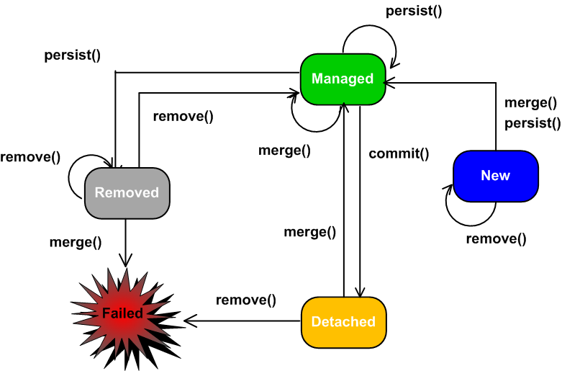
5.2 Lifecycle of an Entity Bean

Slide 29
Example: Entity Instance Synchronization
import javax.persistence.*;
import javax.ejb.*;
@Remote
@Stateless
public class CourseModelImpl implements CourseModel {
// obtaining reference to the persistent data manager
@PersistenceContext private EntityManager emgr;
// method for getting persistent data from the data source
public Student getStudent(String id)
throws CourseException {
Student stud = emgr.find(Student.class, symbol);
if (stud != null){
return stud;
} else {
throw new CourseException(“Student”+symbol+”not found”);
}
}

Slide 30
(cont.)
// method for persisting data in the data source
public void addStudent(Student stud)
throws CourseException {
try {
emgr.persist(stud);
} catch (EntityExistsException ex) {
throws new CourseException (“Duplicate student”+
stud.getID());
}
}
}

Slide 31
5.3 Entity Objects Management
Any changes to the persistent fields, accessed via field methods or directly will be persisted automatically by the container
If you need to force a persistence operation on the entity classes programmatically it can be done using the persistence manager of the container

Slide 32
Persistence Manager Methods
Entity Manger Method | Effect
flush() | forcing the synchronization between the database and the entity in the persistent context
refresh() | refreshing the entity instance in the context
find() | finding an instance by executing a query using the primary key of the entity as a search criteria
contains() | checking for an entity in the persistent context
merge() | merging the state of an entity with the current persistent context
remove() | removing the entity instance
persists() | making an instance managed and persistent
createNativeQuery() | specifying an SQL query for execution

Slide 33
6. Deploying Entity Classes
6.1 Persistent Unit Content
Component | Purpose | Default Location
Managed Entity Classes | Persistent data definition | In folders according to the mapping
Object-Relational Mapping Metadata | Definition of the mapping classes <-> DB tables | Included in the annotations or the xml descriptor file
Entity Manager Factory and Entity Manager | Prescription of library to be used | In default location known to the Java EE application server
Configuration of the EM Factory EM | Configuration | Also in default location
persistence.xml file | Definition of the persistent unit | In the META-IF folder of ejb-jar.xml file

Slide 34
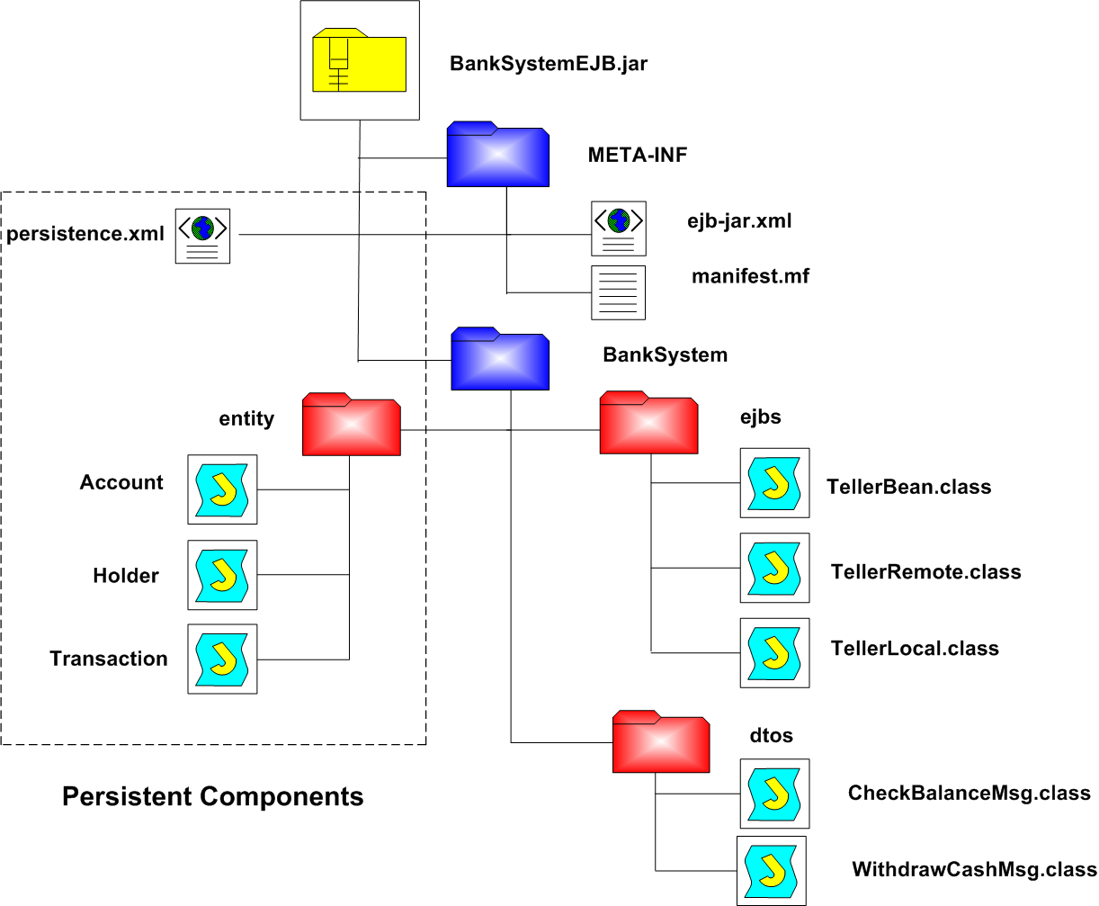
6.2 Structure of the deployment archive with persistence

Slide 35
Summary: Benefits for using JPA
Automatic management of transactions and sessions
  The persistent unit which uses a standard relational database is configured and available for multiple uses through the DataSource class
Automatic synchronization of the persistent data within the program and the external data sources
  The PersistentManager is available for programmatic use through simple reference to the container
Increased efficiency through pooling
  The EJB container maintains a pool of JDBC connections as specified in the server
Better design through separation of concerns
  The Web container is used mainly for presentation layer
  The EJB container implements the façade, business service and business data layers of the application

